Slide 1
Ten-Year Financial Forecast
January 22, 2019

Slide 2
Economic Update
Recession ahead?
Future risks to State economy
Global and regional behavior shifts affecting Santa Monica

Slide 3
Revenue Growth Over Time
Property Tax 3.5-4.5%
Sales Tax 2%-3%
Transient Occupancy Tax 2.5%
Business License Tax 1.5%
Recovery = 8%
Last 3 years = 4%
Next 10 years = 2.3%

Slide 4
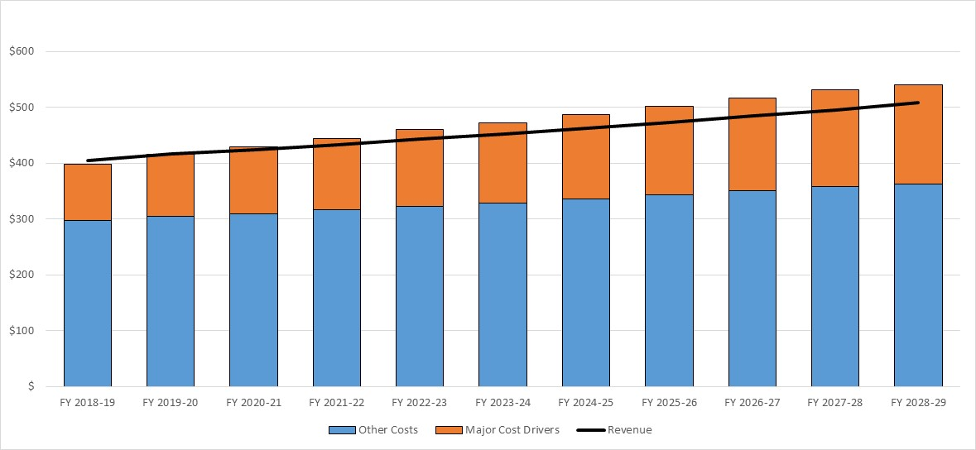
Major cost drivers

Slide 5
Retirement Costs
What we’ve done so far
New challenges
$77.5 million pay down of unfunded liability
More sustainable pension benefits for 1/3 of employees
Prepayments provide discount
Employees sharing more of pension costs
Changed assumptions
Lowered discount rate from 7.5% to 7%
Future paydown of losses amortized over 20 years
Potential for 6.5% or even 6% return by 10 years

Slide 6
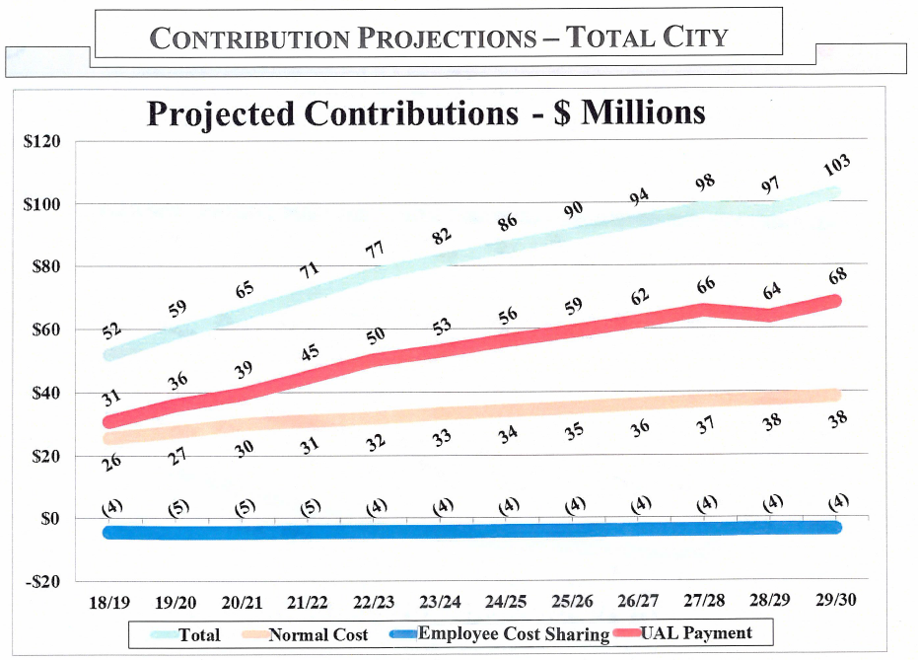
Retirement Costs

Slide 7
General Fund Ten Year Forecast: Revenues and Expenditures
Best
Probable
Recession
Worst

Slide 8
Pension Advisory Committee
11-member advisory committee to City Manager
Adopted Guiding Principles
Recommended accelerated paydown of unfunded liability

Slide 9
Projected Unfunded Liability Payments

Slide 10
Other Funds Status
Self-Sustaining
Wastewater, Water, RRR, BBB, Airport, Beach, Cemetery, Community Broadband
Requiring Subsidy
Pier, Housing

Slide 11
Grants Programs
Human Services Grants Program
Renew grant funding for two years
Reimagined RFP released in Fall 2020
Cultural Arts Organizational Support Program
RFP released in early February 2019
Two year grant cycle

Slide 12
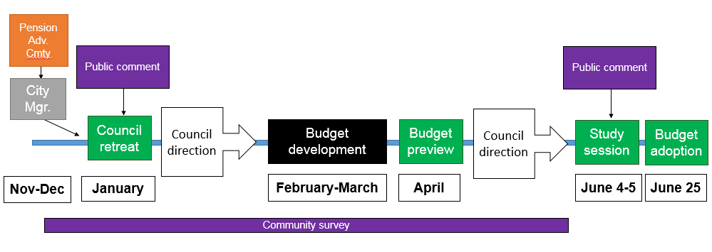
Biennial Budget Process

Slide 13
Recommended Actions
Receive the forecast and direct staff on budget strategy
Renew grant funding for two years for Human Services Grant Program grantees
Receive public comments for CDBG/ HOME funding plans

